Slide 1
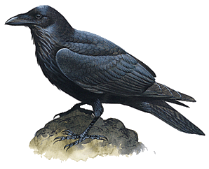
Document Databases & RavenDB
Brian Ritchie
Chief Architect Payformance Corporation
Email: brian.ritchie@gmail.com
Blog: http://weblog.asp.net/britchie
Web: http://www.dotnetpowered.com

Slide 2
What is a database?
When most people say database, they mean relational database.
Why would we need to broaden our definition of a database?
What industry trends are challenging this venerable technology?
Notes:
Relational database: Edgar Codd defined and coined the term at IBM's Almaden Research Center about 40 years ago.
Since that time, relational databases have become the foundation of nearly every enterprise system.

Slide 3
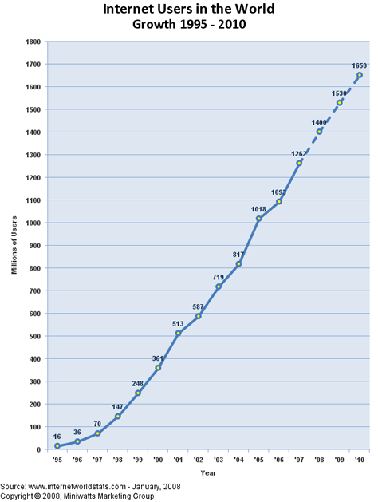
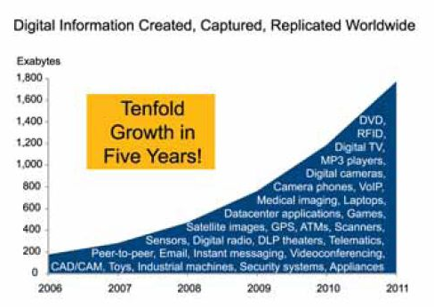
Industry Trends User & Data Explosion
Internet Scale Systems & Large Data growth are overwhelming existing systems
Source: IDC 2008

Slide 4
Industry Trend: Semi Structured Data
Data is no longer simple rows & columns
XML
JSON
Need flexible schemas for multi-tenant systems (SaaS)
Trend accelerated by individual content generation (“web 2.0”)

Slide 5
Industry Trend: Architecture Changes
Database as
Integration Point
Service
Oriented
Mainframe
Client-Server
Application
Application
Application
Application
Service
Service
Data should be stored to meet the needs of the service not forced into a rigid structure.

Slide 6
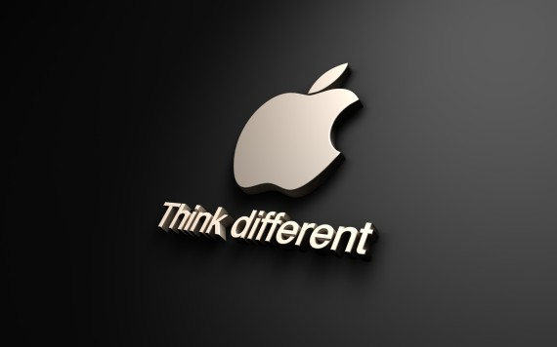
Does database = relational database?

Slide 7

What about NOSQL?
According to NOSQL-databases.org:
Next Generation Databases address some of the following points: being non-relational, distributed, open-source and horizontal scalable. The original intention has been modern web-scale databases. The movement began early 2009 and is growing rapidly. Often more characteristics apply as: schema-free, replication support, easy API, eventually consistency, and more. So the misleading term "NOSQL" (the community now translates it mostly with "not only sql") should be seen as an alias to something like the definition above.

Slide 8





Who is using NOSQL?
Notes:
Twitter generates 7TB/day (2PB+ year) – Hadoop for data analysis, Scribe for logging
LinkedIn - Voldemort

Slide 9

Advantages of NOSQL
Cheap, easy to implement
Removes impedance mismatch between objects and tables
Quickly process large amounts of data
Data Modeling Flexibility (including schema evolution)
Disadvantages of NOSQL
New Technology
Data is generally duplicated, potential for inconsistency
No standard language or format for queries
Depends on the application layer to enforce data integrity
Notes:
Scalability: relational databases were not designed to handle and do not generally cope well with Internet-scale, “big data” applications. Most of the big Internet companies (e.g., Google, Yahoo, Facebook) do not rely on RDBMS technology for this reason.

Slide 10
Types of NOSQL Databases
Document (MongoDB, CouchDB, RavenDB)
Graph (Neo4J, Sones)
Key/Value (Cassandra, SimpleDB, Dynamo, Voldemort)
Tabular/Wide Column (BigTable, Apache Hbase)
http://NOSQL-databases.org
Notes:
Cassandra – Facebook Inbox Search
Amazon Dynamo: not open source Voldemort: Open-Source implementation of Amazons Dynamo Key-Value Store.
Google Big Table: a sparse, distributed multi-dimensional sorted map

Slide 11
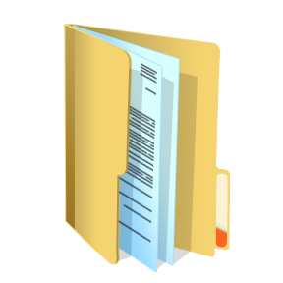
What is a document database?
Documents
JSON, or derivatives
XML
Schema free
Documents are independent
Non relational
Run on large number of machines
Data is partitioned and replicated among these machines

Slide 12
A document…defined
A document can contain any number of fields of any length can be added to a document. Fields can also contain multiple pieces of data.
Examples of documents:
FirstName="Bob", Address="5 Oak St.", Hobby="sailing"
FirstName="Jonathan", Address="15 Wanamassa Point Road", Children=("Michael,10", "Jennifer,8", "Samantha,5", "Elena,2")
http://en.wikipedia.org/wiki/Document-oriented_database

Slide 13
Top Document Databases
A few of the top document databases are CouchDB, RavenDB, and MongoDB.
CouchDB is an Apache project created by Damien Katz (built using Erlang) and just reached a 1.0 status.
RavenDB is built on using C# and has some interesting extension capabilities using .NET classes. RavenDB was created by Ayende Rahien.
MongoDB is written in C++ and provides some unique querying capabilities. MongoDB was originally developed by 10gen.
Notes:
A few of the top document databases are CouchDB, RavenDB, and MongoDB.
CouchDB is an Apache project created by Damien Katz (built using Erlang) and just reached a 1.0 status. Damien has a background working on Lotus Notes & MySql.
RavenDB is built on using C# and has some interesting extension capabilities using .NET classes. RavenDB was created by Ayende Rahien. Ayende Rahien is the creator of Rhino Mocks & much more.
MongoDB is written in C++ and provides some unique querying capabilities. MongoDB was originally developed by 10gen.

Slide 14
Why use a document database?
Objects can be stored as documents
Documents can be complex
Documents are independent
Open Formats
Schema free
Notes:
Objects can be stored as documents: The relational database impedance mismatch is gone. Just serialize the object model to a document and go.
Documents can be complex: Entire object models can be read & written at once. No need to perform a series of insert statements or create complex stored procs.
Documents are independent: Improves performance and decreases concurrency side effects. Low overhead – one read, one write.
Open Formats: Documents are described using JSON or XML or derivatives. Clean & self-describing.
Schema free: Strict schemas are great, until they change. Schema free gives flexibility for evolving system without forcing the existing data to be restructured.

Slide 15
Where do document databases fit?
A few examples…
Large Data Sets
Web Related Data
Customizable Dynamic Entities
Persisted View Models
Notes:
Web Related Data, such as user sessions, shopping cart, etc. - Due to its document based nature means that you can retrieve and store all the data required to process a request in a single remote call.
Dynamic Entities, such as user-customizable entities, entities with a large number of optional fields, etc. - The schema free nature means that you don't have to fight a relational model to implement it.
Persisted View Models - Instead of recreating the view model from scratch on every request, you can store it in its final form in a document database. That leads to reduced computation, reduced number of remote calls and improved overall performance.
Large Data Sets - The underlying storage mechanism for Raven is known to scale in excess of 1 terabyte (on a single machine) and the non relational nature of the database makes it trivial to shard the database across multiple machines, something that Raven can do natively.

Slide 16
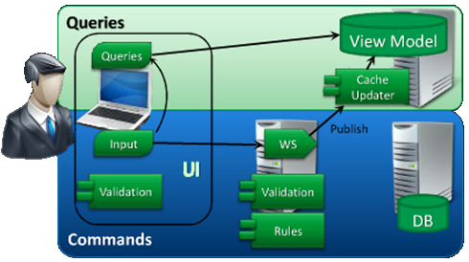
Persistent View Model
Utilized by CQRS (Command Query Responsibility Segregation)
Instead of recreating the view model from scratch on every request, you can store it in its final form
Notes:
In a multi-user environment, data on the screen is always stale. Due to this fact, we don't need a complicated ORM to pull "live" data out of our OLTP database.
The user interface needs to capture the user's intent, not just their input. It can then build up commands that are submitted asynchronously to the services layer. This is a more imperative way of doing things and provides the opportunity to inject business processes without changing the user interface. This allows our backend process to have as much time as it needs to perform the business logic & update the database.
Udi Dahan

Slide 17

What does Raven DB have to offer?
Built on existing infrastructure (ESENT) that is known to scale to amazing sizes
Not just a server. You can easily (trivially) embed Raven inside your application.
It’s transactional. That means ACID, if you put data in it, that data is going to stay there.
Supports System.Transactions and can take part in distributed transactions.
Allows you to define indexes using Linq queries.
Supports map/reduce operations on top of your documents using Linq.
Comes with a fully functional .NET client API, which implements Unit of Work, change tracking, read and write optimizations, and a bunch more.
Notes:
ESENT can handle up to 16 terrabytes on a single machine. Many teams at Microsoft—including The Active Directory, Windows Desktop Search, Windows Mail, Live Mesh, and Windows Update—currently rely on ESENT for data storage. And Microsoft Exchange stores all of its mailbox data (a large server typically has dozens of terrabytes of data) using a slightly modified version of the ESENT code. Part of Windows since Windows 2000.

Slide 18
What does Raven DB have to offer?
Nice web interface allowing you to see, manipulate and query your documents.
Is REST based, so you can access it via the java script API directly.
Can be extended by writing MEF plugins.
Has trigger support that allow you to do some really nifty things, like document merges, auditing, versioning and authorization.
Supports partial document updates, so you don’t have to send full documents over the wire.
Supports sharding out of the box.
Is available in both OSS and commercial modes.
http://ayende.com/Blog/archive/2010/05/13/why-raven-db.aspx
Notes:
ESENT can handle up to 16 terrabytes on a single machine. Many teams at Microsoft—including The Active Directory, Windows Desktop Search, Windows Mail, Live Mesh, and Windows Update—currently rely on ESENT for data storage. And Microsoft Exchange stores all of its mailbox data (a large server typically has dozens of terrabytes of data) using a slightly modified version of the ESENT code. Part of Windows since Windows 2000.

Slide 19
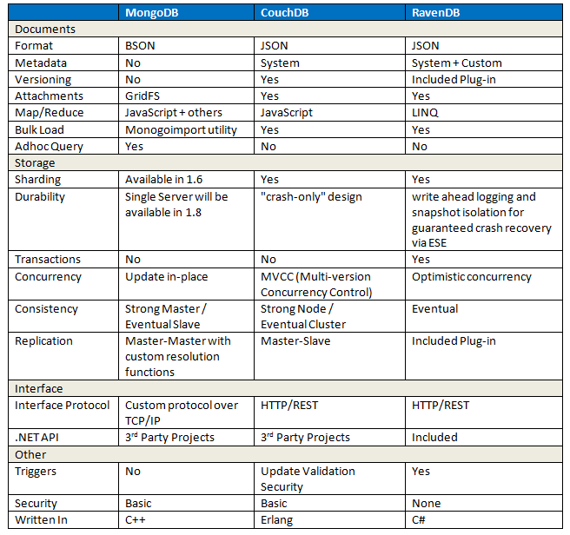
Comparison: Couch/Mongo/Raven

Slide 20
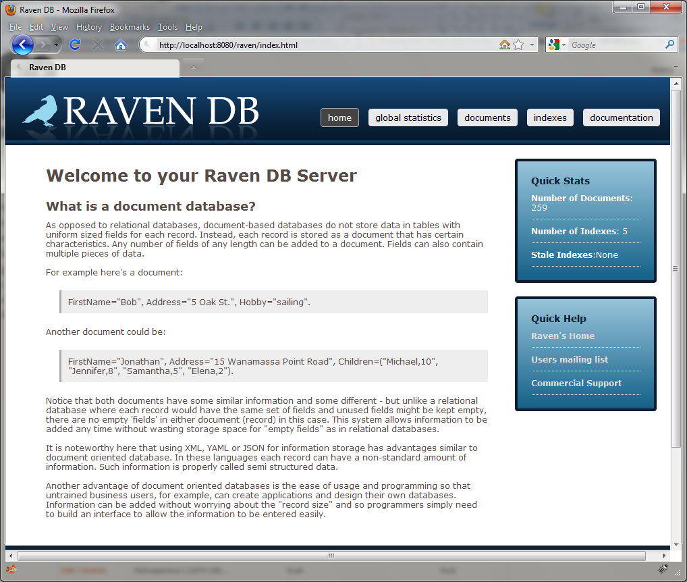
Raven Administration UI

Slide 21
Raven APIs
HTTP
.NET with JSON
.NET with objects

Slide 22
Storing & Retrieving Documents
HTTP API
curl -X PUT http://localhost:8080/docs/bob -d "{ Name: 'Bob', HomeState: 'Maryland', ObjectType: 'User' }"
curl -X GET http://localhost:8080/docs/bob
DEMO

Slide 23
Storing & Retrieving Documents
C# JSON API
var client = new ServerClient("http://localhost:8080", null, null);
client.Put("bob", null, JObject.Parse("{ Name: 'Bob', HomeState: 'Maryland', ObjectType: 'User' }"), null);
JsonDocument jo = client.Get(“bob”);
DEMO

Slide 24
Storing & Retrieving Documents
C# Class API
var ds = new DocumentStore() { Url = "http://localhost:8080" };
var entity = new User() { Name = "Bob", HomeState = "Maryland" };
using (var session = ds.OpenSession())
{
session.Store(entity);
session.SaveChanges();
}
DEMO

Slide 25
Indexing
Brings order in schema-free world
Materialized views
Built in the background
Allow stale reads
Don’t slow down CRUD ops
MapReduce functions using LINQ

Slide 26
MapReduce: How does it work?
Map
Reduce →
[ Orange ]
[ Blue ]
[ Orange,2 ]
[ Blue ]
[ Blue,2 ]
[ Orange,2 ]
[ Orange ]
[ Blue,3 ]
[ Red,1 ]
[ Blue ]
[ Blue,1 ]
[ Red,1 ]
[ Red ]

Slide 27
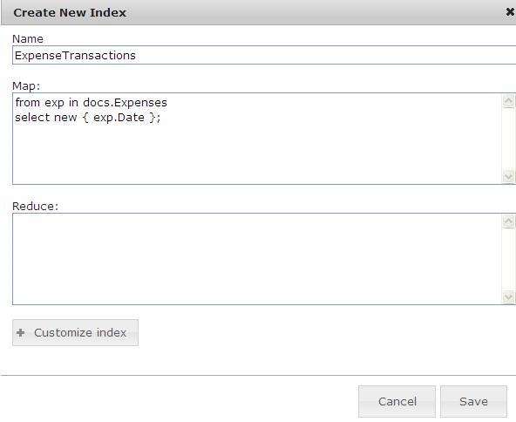
Indexing Demo

Slide 28
Eventual Consistency
The CAP theorem (Brewer) states that you have to pick two of Consistency, Availability, Partition tolerance: You can't have the three at the same time and get an acceptable latency.
Consistency means that each client always has the same view of the data.
Availability means that all clients can always read and write.
Partition tolerance means that the system works well across physical network partitions.
Eventual consistency relaxes consistency for availability & partition tolerance. By doing this it also gains scalability.

Slide 29
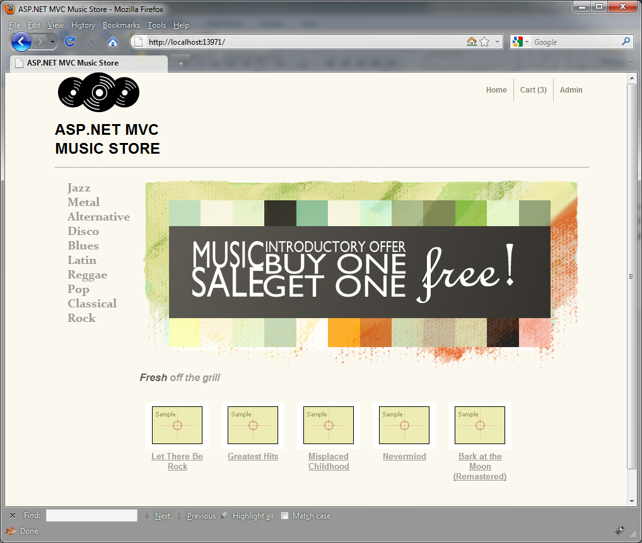
ASP.NET MVC STORE meets RavenDB
Notes:
ASP.NET Music Store Sample
http://www.asp.net/mvc/samples/mvc-music-store
Ayende blog post on Porting sample to Raven
http://ayende.com/Blog/archive/2010/05/18/porting-mvc-music-store-to-raven-the-data-model.aspx

Slide 30
Advanced Topics
Replication
Sharding
Extensibility

Slide 31
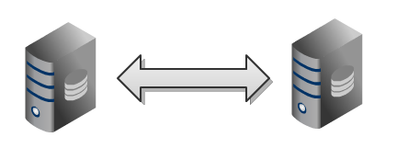
Replication Between Servers
Implemented as a plug-in (Raven.Bundles.Replication.dll)
Tracks the server the document was originally written on.
The replication bundle uses this information to determine if a replicated document is conflicting with the existing document.
Supported by the client API
Detects that an instance is replicating to another set of instances.
When that instance is down, will automatically shift to the other instances.

Slide 32
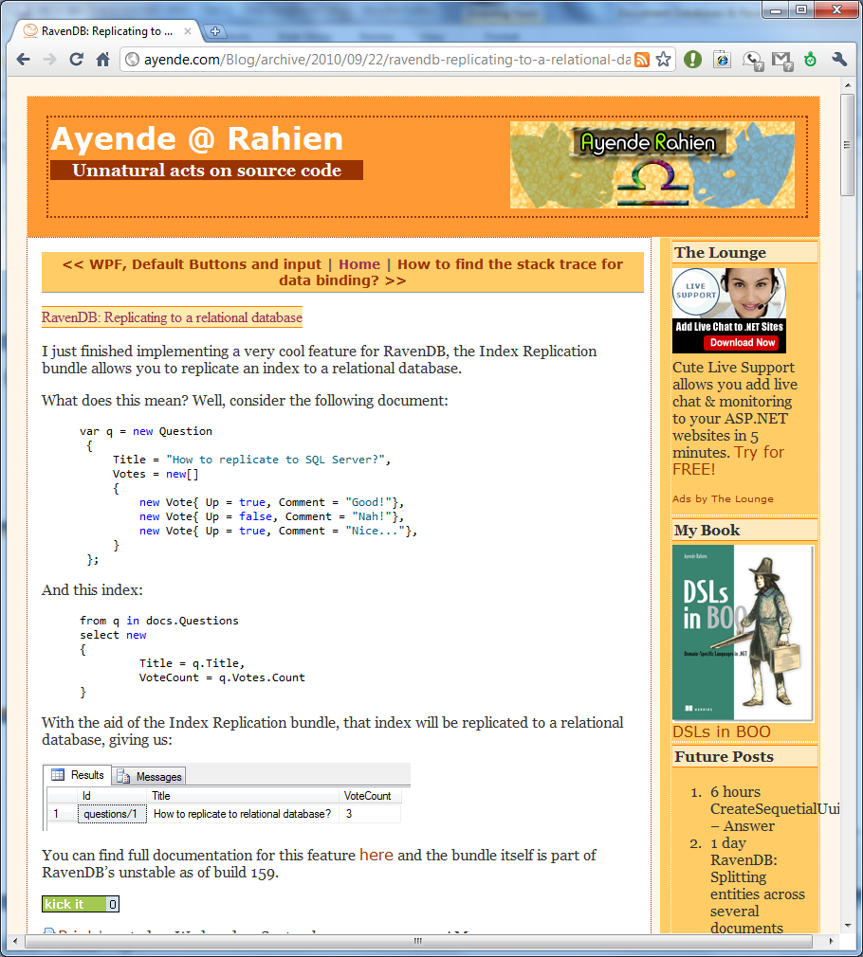
Replication to Relational DB
Given this document…
And this index…
Gives this table output
http://ravendb.net/bundles/index-replication

Slide 33
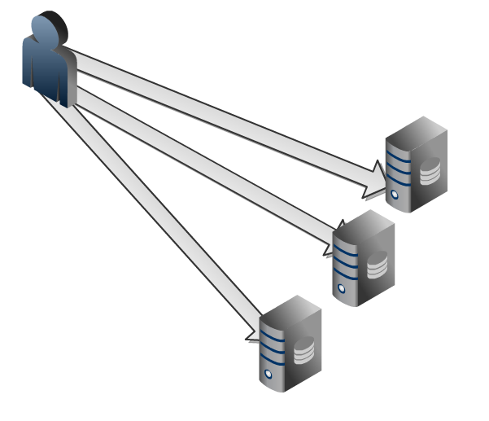
Sharding
Sharding refers to horizontal partitioning of data across multiple machines.
The idea is to split the load across many commodity machines, instead of buying huge expensive machines.
Raven has full support for sharding, and you can utilize sharding out of the box.

Slide 34
Extensibility
MEF (Managed Extensibility Framework)
Triggers
PUT triggers
DELETE triggers
Read triggers
Index update triggers
Request Responders
Custom Serialization/Deserialization

Slide 35
Learn More!
Raven DB Home Page http://ravendb.net/
Raven DB: An Introduction http://www.codeproject.com/KB/cs/RavenDBIntro.aspx
Herding Code 83: Ayende Rahien on RavenDB http://herdingcode.com/?p=255
Raven posts from Ayende Rahien http://ayende.com/Blog/category/564.aspx
Raven posts from Rob Ashton http://codeofrob.com/category/13.aspx
My blog http://weblogs.asp.net/britchie/archive/tags/RavenDB/default.aspx
ESENT (Raven DB’s storage engine)
http://blogs.msdn.com/b/windowssdk/archive/2008/10/23/esent-extensible-storage-engine-api-in-the-windows-sdk.aspx
http://managedesent.codeplex.com/wikipage?title=ManagedEsentDocumentation&referringTitle=Documentation

